Slide 1
MCMCglmm for comparative analysis and for data imputation

Slide 2

Yesterday we ran into the problem of non-independent data.
y
x₁

Slide 3
Really common problem in Biology
y
x₁

Slide 4
Random effect
y
We are assuming that data points within each group are equally related
x₁

Slide 5
Random effect
y
We are assuming that data points within each group are equally related
x₁

Slide 6
Kingdom Phyla Class Order Family Genus Species Population individual

Slide 7
Nested
y
Red points more related to each other than all other points but two groups also within red.
x₁

Slide 8
We can imagine these as groups. However there is lot more information in there. Its hierarchical and continuous

Slide 9
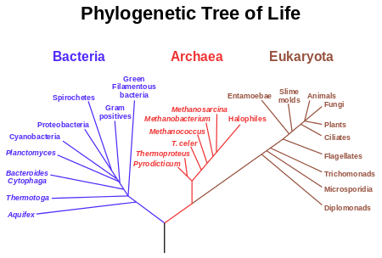

Slide 10
http://www.onezoom.org

Slide 11
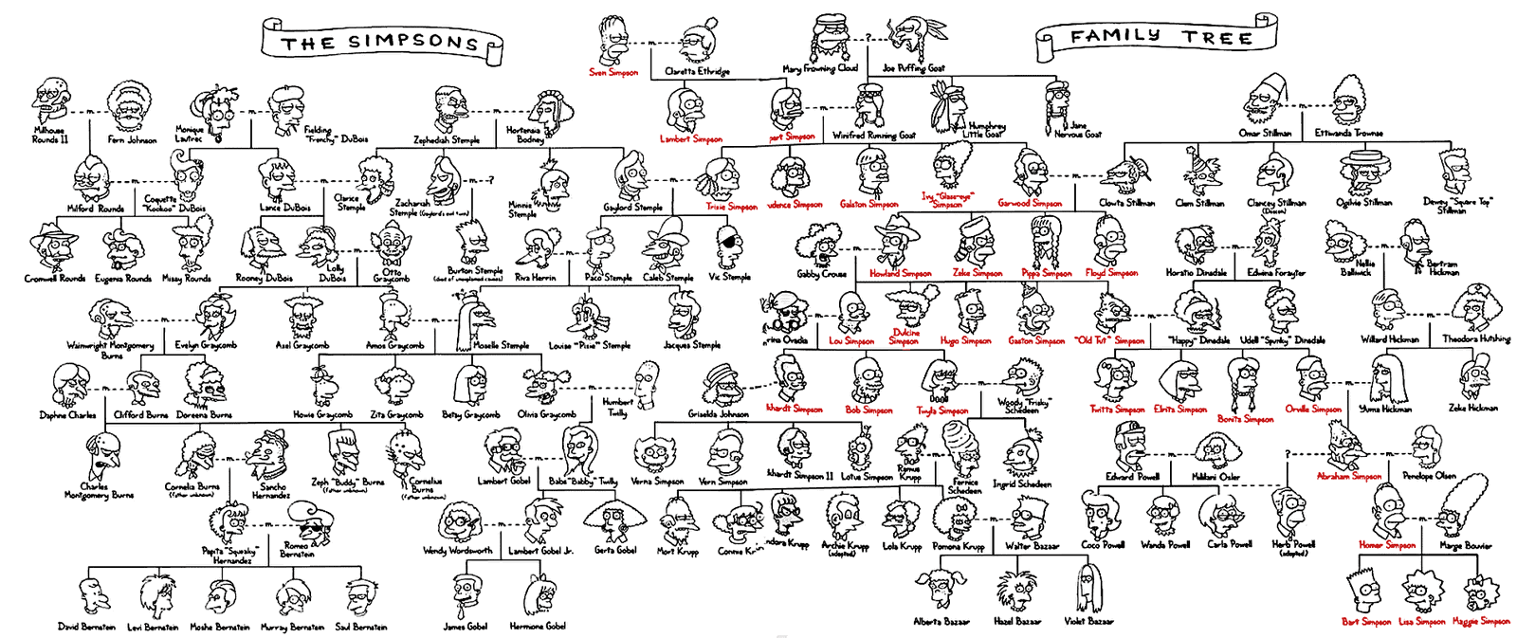

Slide 12

Build a phylogeny

Slide 13
Use the distance between species

Slide 14
Speciation
Present

Slide 15
Assume evolution is a Brownian walk
Speciation
Traits evolution
Present

Slide 16
Use distance on phylogeny
y
x₁

Slide 17
Use distance on phylogeny
y
x₁

Slide 18
Lynch et al 2007

Slide 19
Lynch et al 2007

Slide 20
Use distance on phylogeny
y
x₁

Slide 21
Variance co-variance matrix
10
10
10
10

Slide 22
Variance co-variance matrix
4
10
4
4
10
10

Slide 23
Variance co-variance matrix
2
10
4
2
4
10
2
2
2
10

Slide 24
y = Xβ + Zu + e
Zu is now a VCV
10
4
2
4
10
2
2
2
10

Slide 25
Assume Brownian motion
y = Xβ + Zu + e
Zu is now a VCV
10
4
2
4
10
2
2
2
10

Slide 26
Pagels lambda
10
4
2
X λ
4
10
2
2
2
10

Slide 27
Pagels lambda
λ = 1
10
4
2
X 1
4
10
2
2
2
10

Slide 28
Pagels lambda
λ = 0
0
0
0
X 0
0
0
0
0
0
0

